Slide 1
TRAFFIC ANALYSIS
SYSTEM
Guided By:-
Dr. Anjali Kapoor
Dr. Ram Paul Hathwal
Presented By:-
Yashika
Saksham Jain
Hemant Rana
Arvind Rana

Slide 2
Contents
Problem Statement
Software Used
Features of our Model
Building the Model
System Architecture
Vehicle Detection, Tracking and Counting : a working Example
Results
References

Slide 3

Problem Statement
Analysis of the traffic passed through the particular road. Evaluation of video file includes classification of vehicle type and vehicles description i.e. vehicles color, size, approximate speed, direction of travel. So that proper analysis of the traffic at that point can be done.

Slide 4
Softwares / Tools used:
Jupyter Notebook IDE
Anaconda Environment
Python 3
OpenCV
TensorFlow Object Detection API

Slide 5

TensorFlow
TensorFlow is an open source software library for numerical computation using data flow graphs.
Nodes in the graph represent mathematical operations, while the graph edges represent the multidimensional data arrays (tensors) communicated between them.

Slide 6

OpenCV
Open Source Computer Vision Library.
It is an open source computer vision and machine learning software library.
Provides a common infrastructure for computer vision applications and to accelerate the use of machine perception in the commercial products.

Slide 7
Features of our Model
Detection and classification of the vehicles
Recognition of approximate vehicle color.
Detection of vehicle direction of travel.
Prediction the speed of the vehicle.
Prediction of approximate vehicle size.

Slide 8
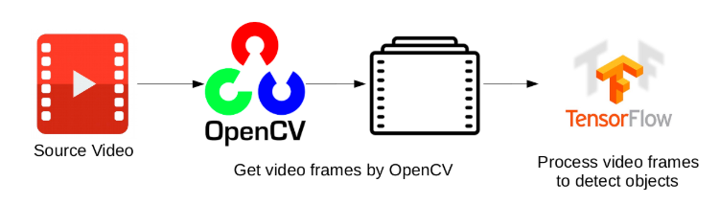

Slide 9
Building the Model
Vehicle detection and classification have been developed using Opencv with a custom built haar cascade classifier specifically for vehicles.
Video feed has been captured and processed using OpenCV library.
Vehicle color prediction has been developed using OpenCV via K-Nearest Neighbors Machine Learning Classification Algorithm is Trained Color Histogram Features.
Tensorflow will be used for training a neural network model for predicting waiting time.

Slide 10
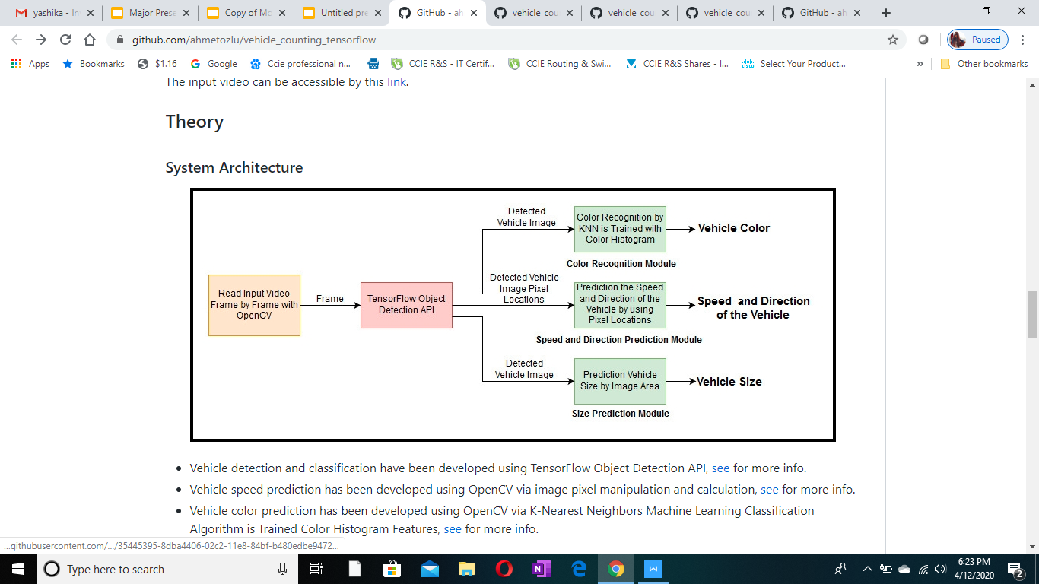
System Architecture

Slide 11
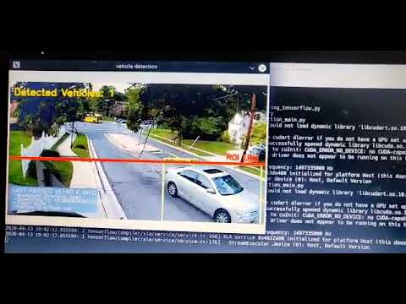
Sample Output

Slide 12
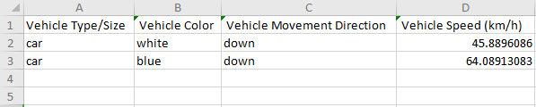
Results

Slide 13
References
Araghi, S., Khosravi, A., Johnstone, M., & Creighton, D. . Intelligent traffic light control of isolated intersections using machine learning methods. In 2013 IEEE International Conference on Systems, Man, and Cybernetics (pp. 3621-3626). IEEE.
Tensorflow docs https://www.tensorflow.org/api_docs/python/
OpenCV docs https://docs.opencv.org/2.4/doc/tutorials/tutorials.html

Slide 14

Any Questions?

